Slide 1



Introduction to Apalache
Xiaosong Gu
2022年03月31日

Slide 2
Contents
What is Apalache
Apalache vs. TLC
How to Use Apalache
Some Rules for Apalache Assignment

Slide 3
What is Apalache

Slide 4
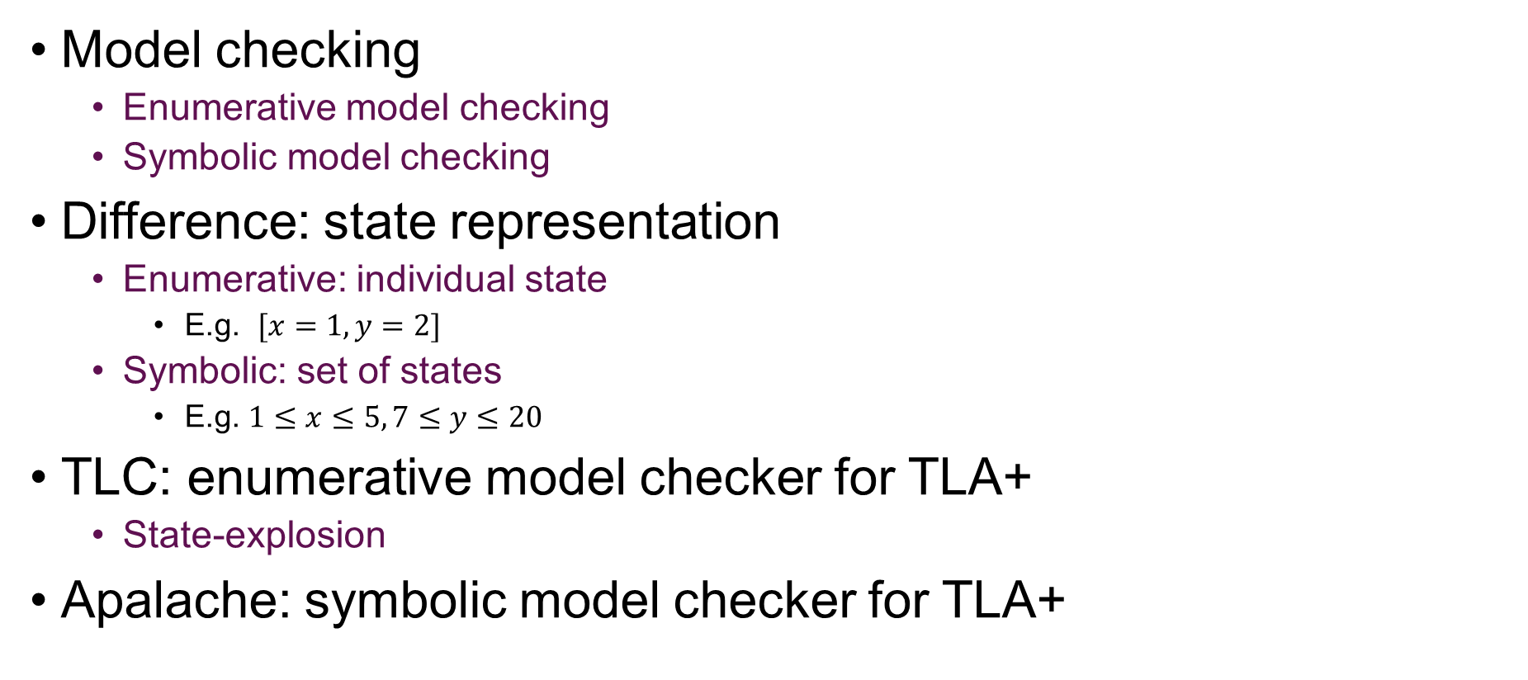
What is Apalache
Model checking
Enumerative model checking
Symbolic model checking
Difference: state representation
Enumerative: individual state
E.g. $[x=1,y=2]$
Symbolic: set of states
E.g. $1≤x≤5, 7≤y≤20$
TLC: enumerative model checker for TLA+
State-explosion
Apalache: symbolic model checker for TLA+
Notes:
建立一个状态图，遍历这个图，枚举每一个状态

Slide 5
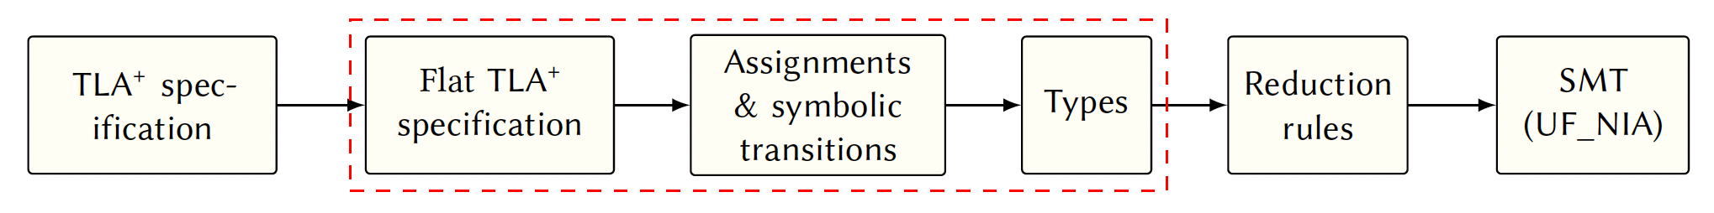
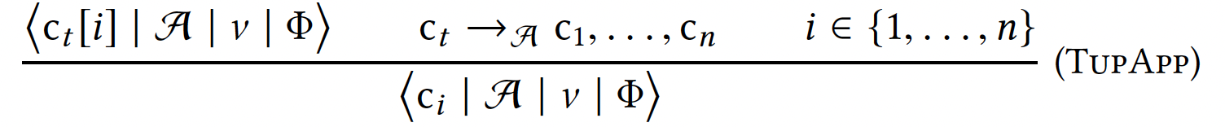
Apalache Workflow
Symbolic transitions: find all assignments
Types: add type to variables
Reduction rules: produce quantifier-free SMT formulas
Notes:
由z3求解

Slide 6
Apalache vs. TLC

Slide 7
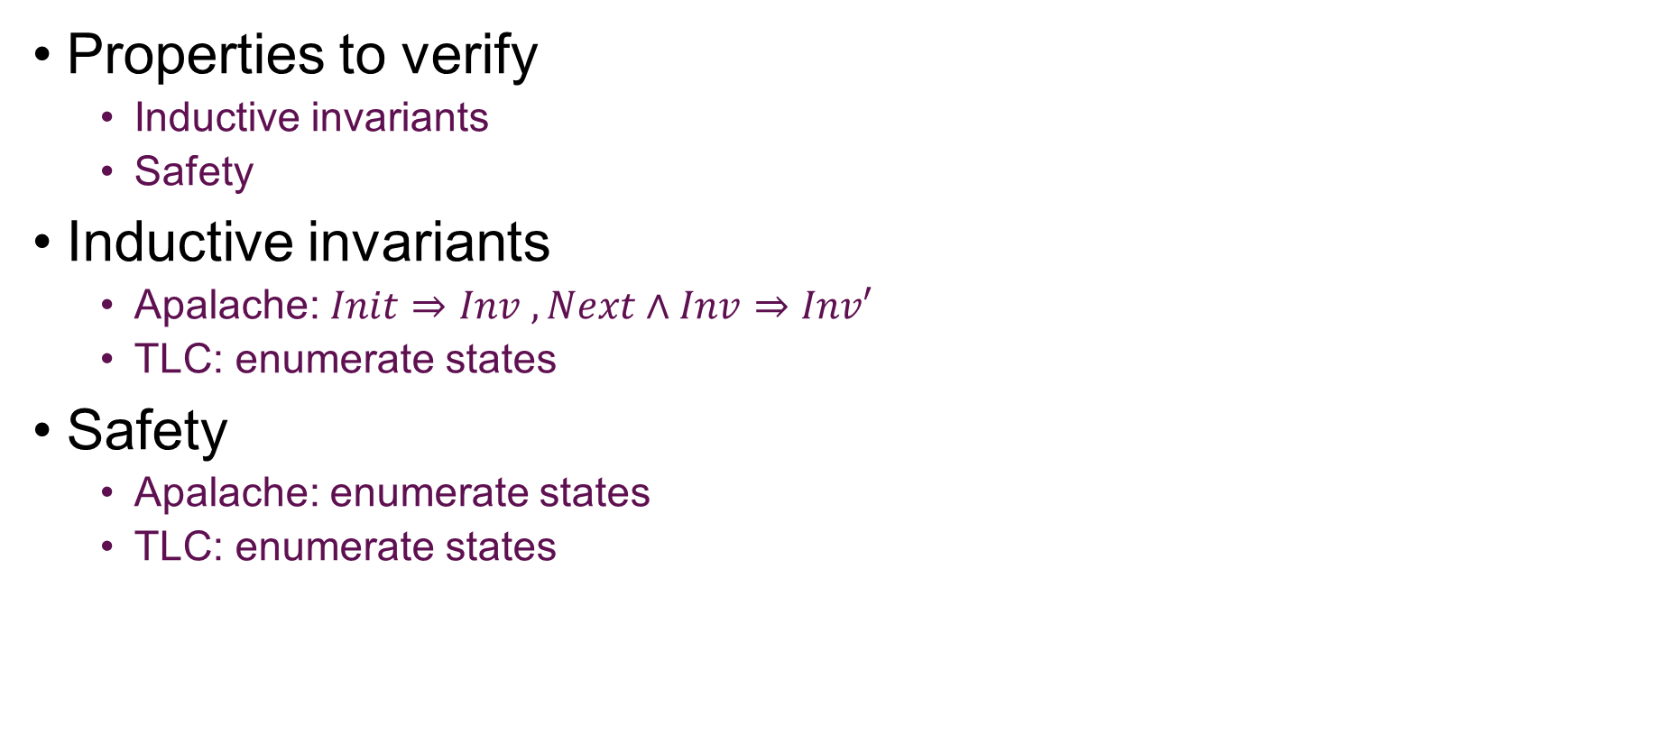
Apalache vs. TLC
Properties to verify
Inductive invariants
Safety
Inductive invariants
Apalache: $Init⇒Inv , Next∧Inv⇒Inv′$
TLC: enumerate states
Safety
Apalache: enumerate states
TLC: enumerate states
Notes:
Tlc 对于这两种是相同的
Apalache不同，验证invariant不需要枚举

Slide 8
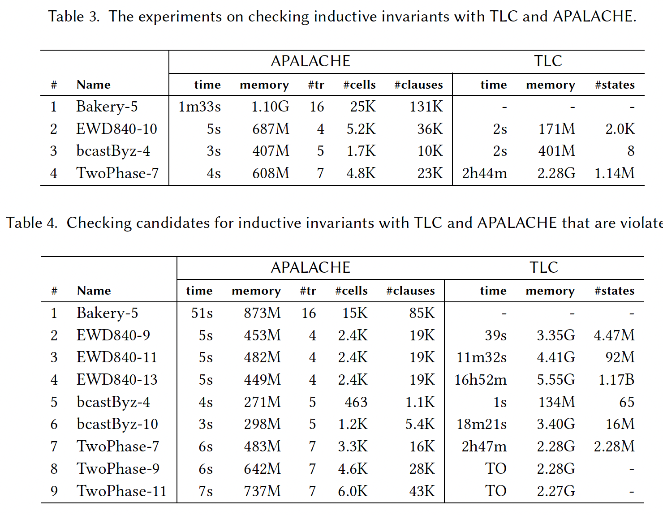
Experiment Results with Inductive Invariants

Slide 9
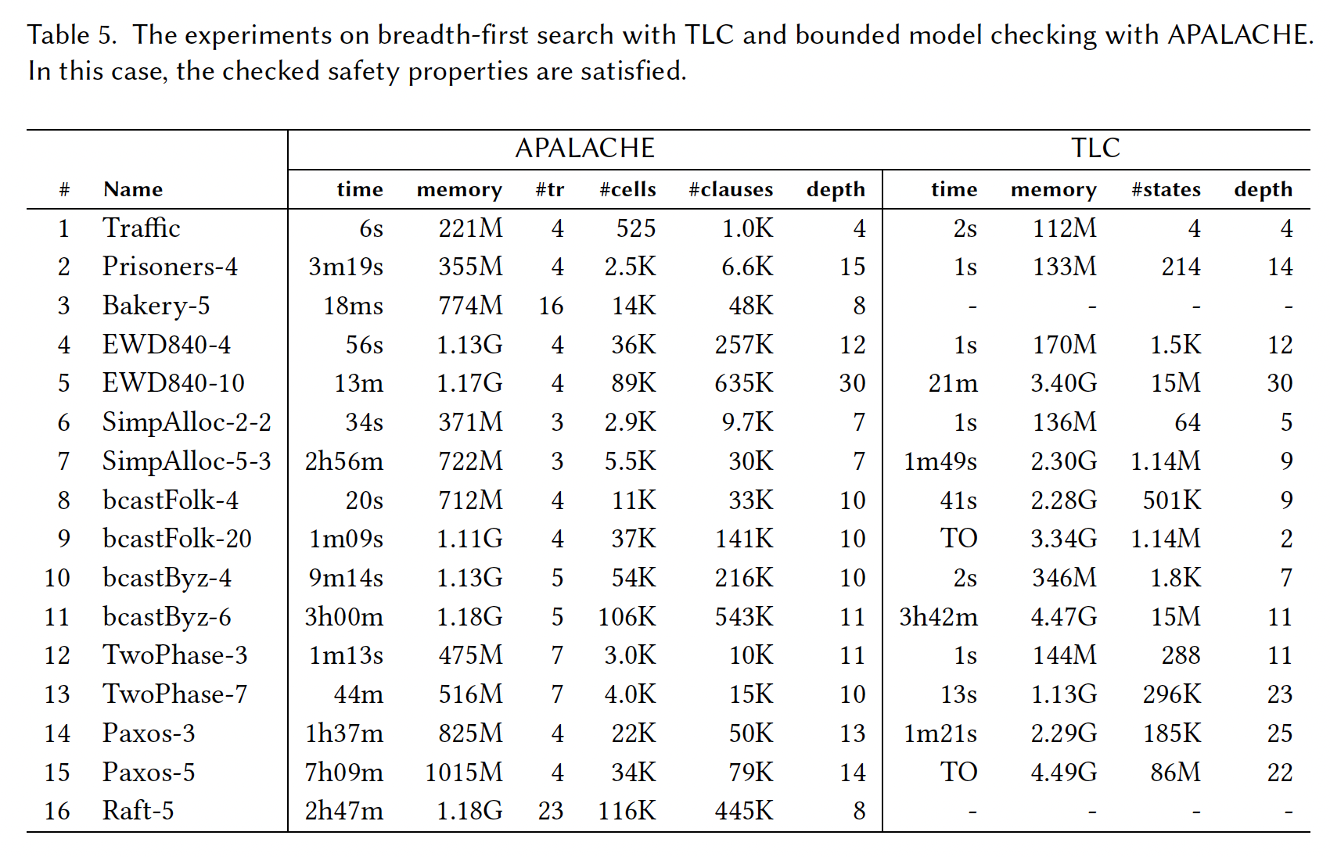
Experiment Results with Safety

Slide 10
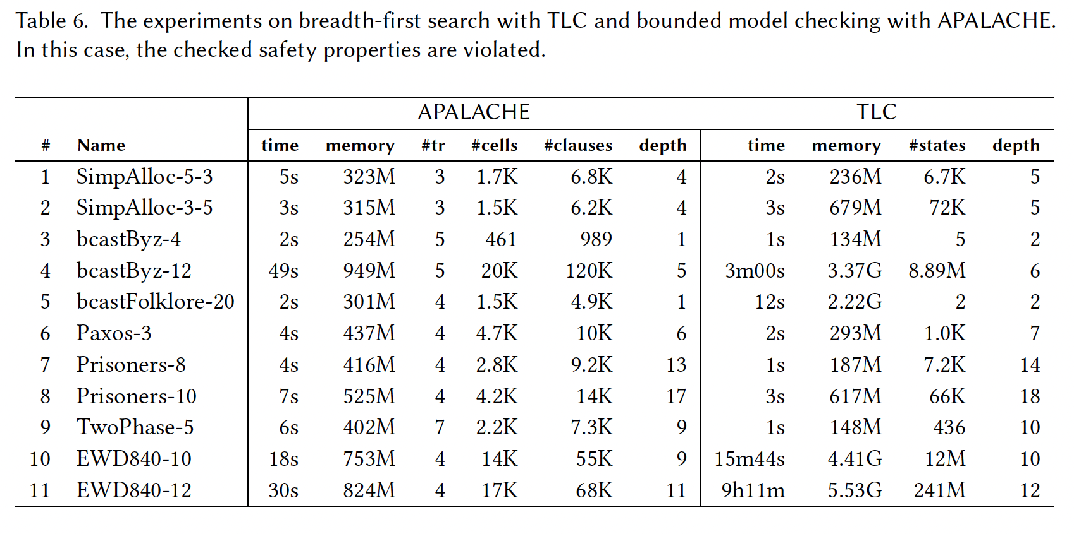
Experiment Results with Safety

Slide 11
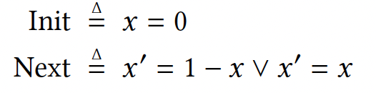
Performance Discussion
Two sources of slowdown in Apalache
Non-deterministic control
SMT encoding needs solver tuning
Portfolio of SMT solvers and encodings

Slide 12
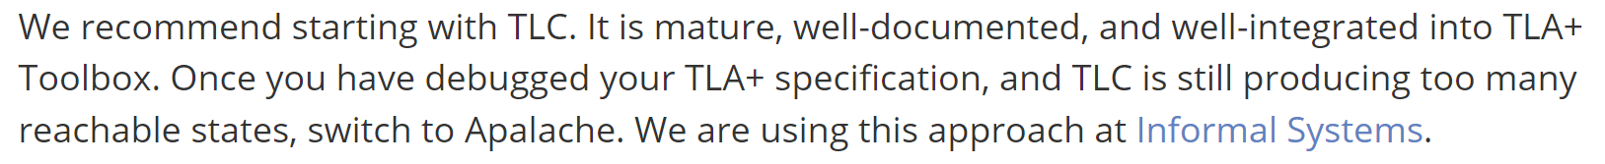
Shall I Use Apalache or TLC?

Slide 13
How to Use Apalache
Notes:
大多数跟tla是一样的，但是有的地方比tla更强大，有的又增加了限制

Slide 14
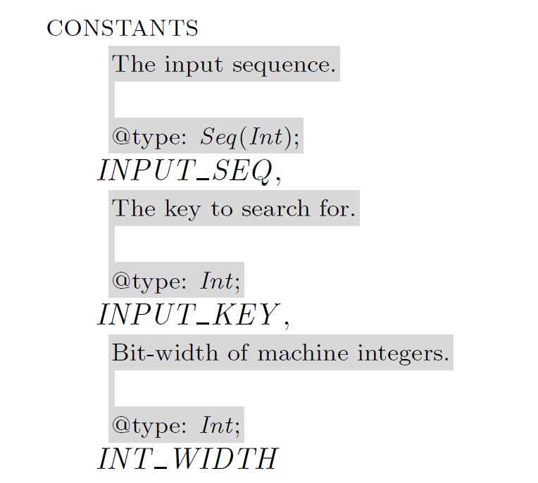
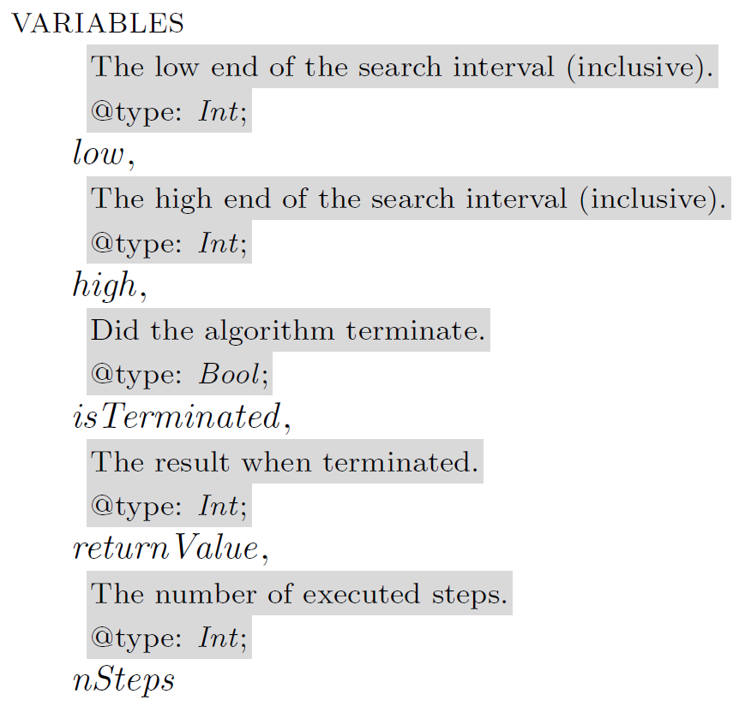
Example: Quicksort
Notes:
需要通过注解的方式添加类型声明
有自动的类型推断系统

Slide 15
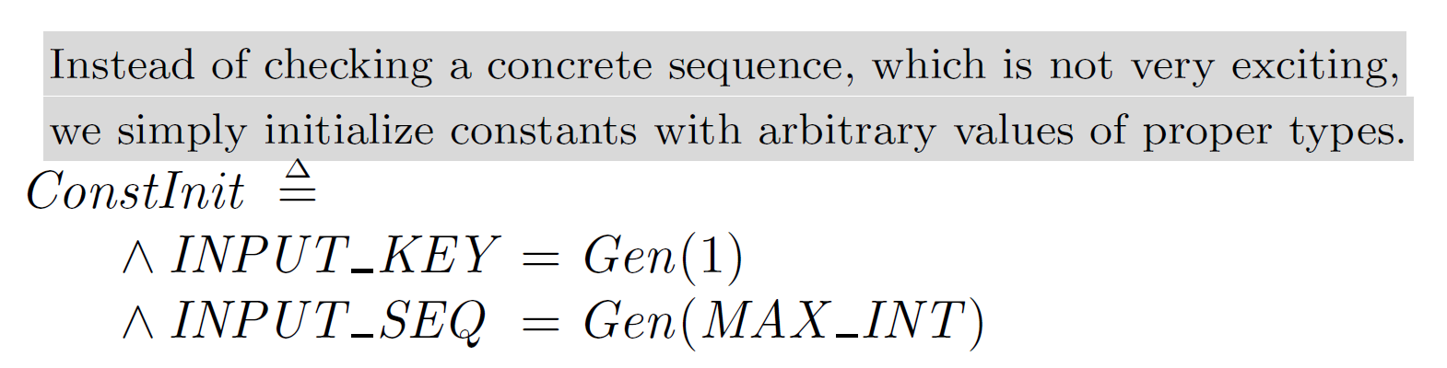
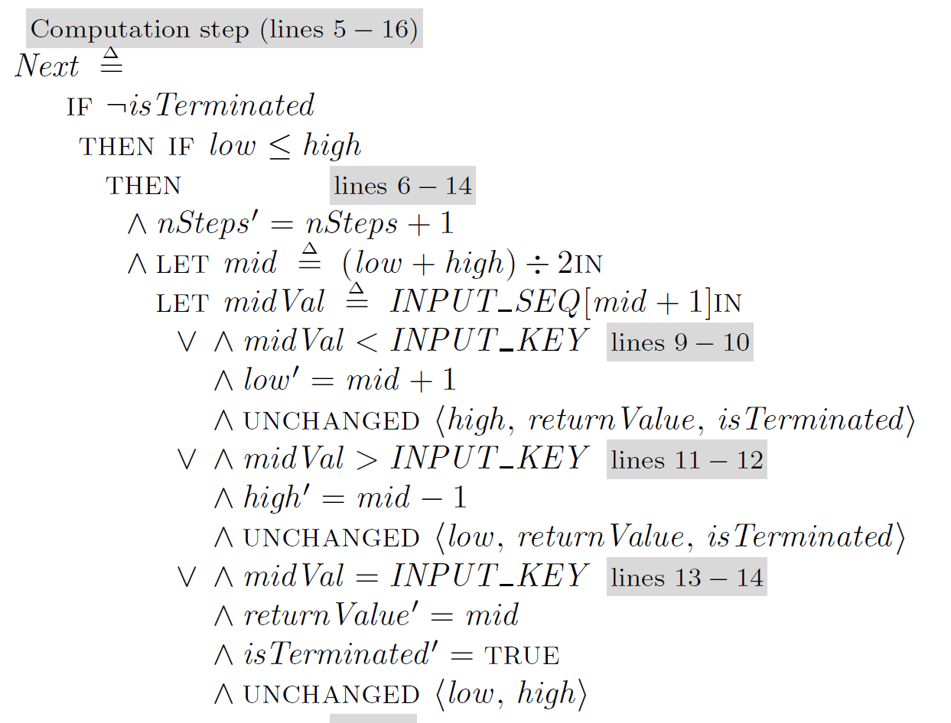
Example: Quicksort
More powerful assignment to constants
Notes:
Constant initializer

Slide 16
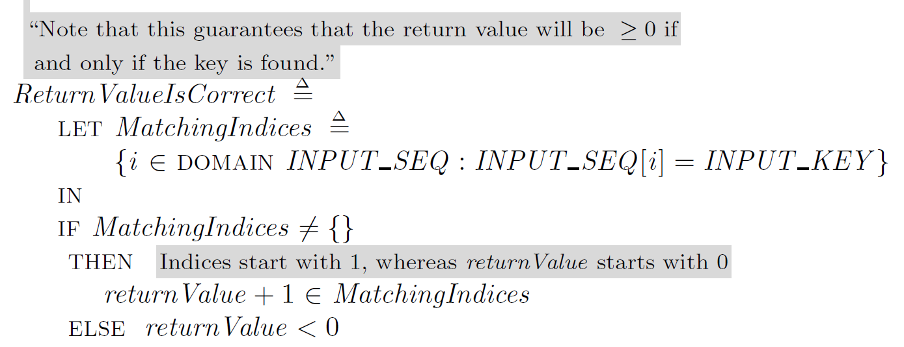
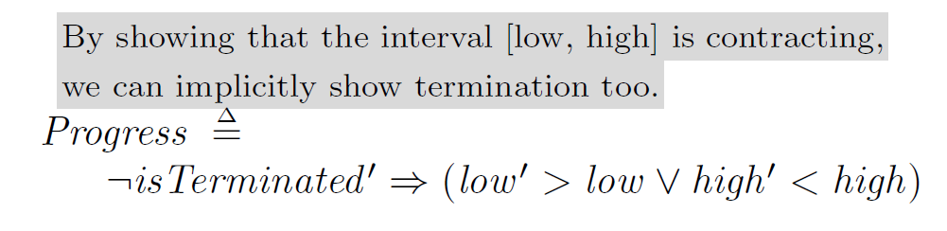
Example: Quicksort
Checking more properties
Notes:
Progress性质在TLC里无法检查

Slide 17
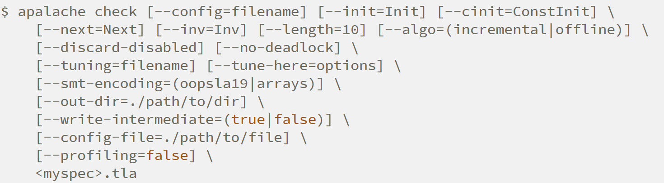
Checking Quicksort

Slide 18
Checking Quicksort
Bounded model checking is incomplete
If a bug needs a long execution to get revealed, bounded model checking may miss it
Checking an inductive invariant
IndInit
IndNext
IndProp

Slide 19
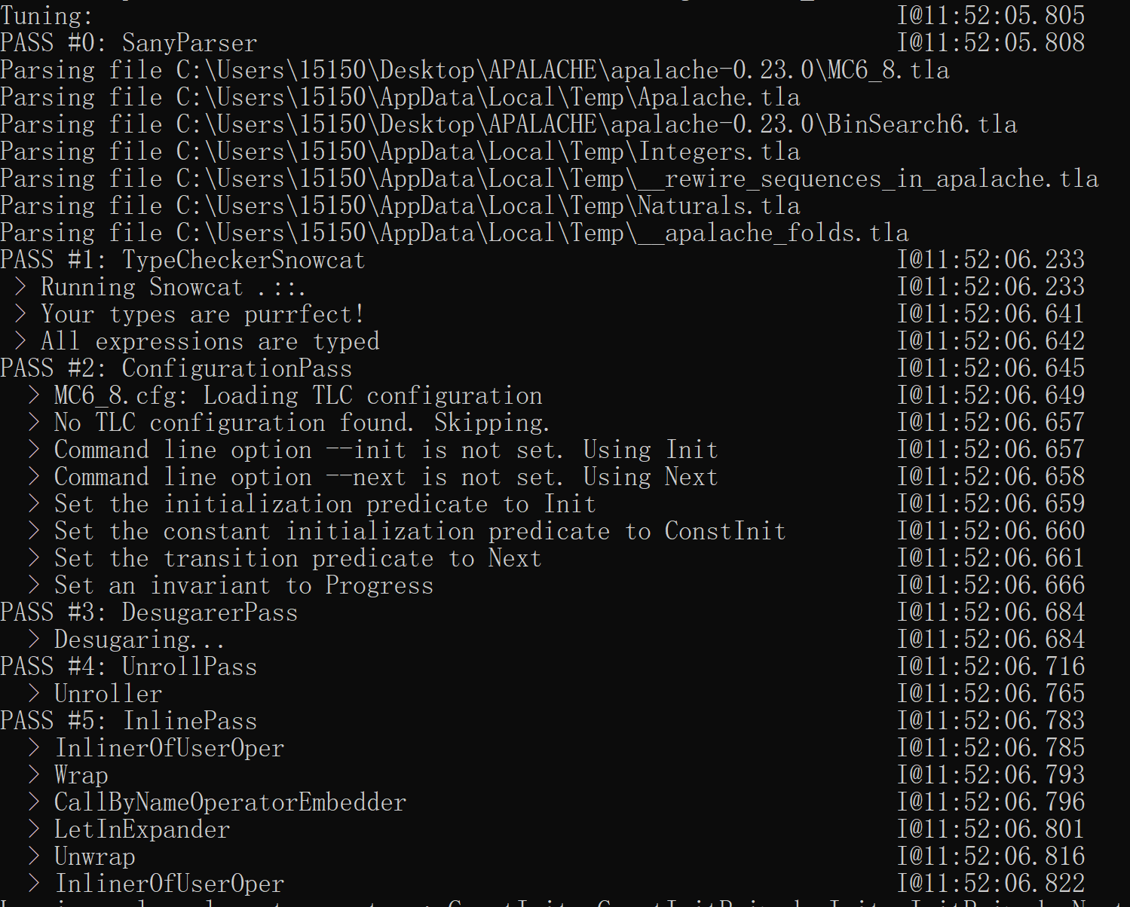
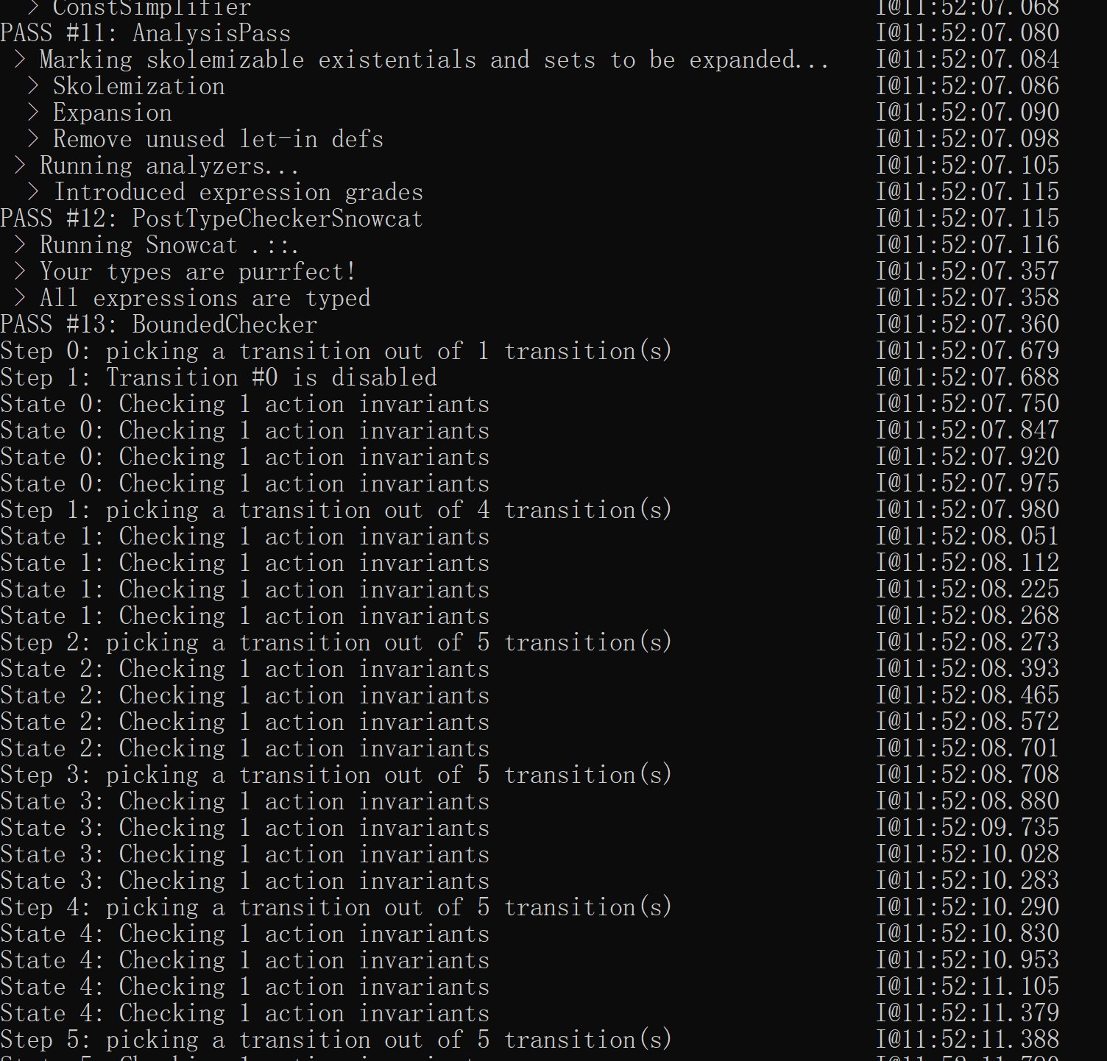
Checking Quicksort

Slide 20
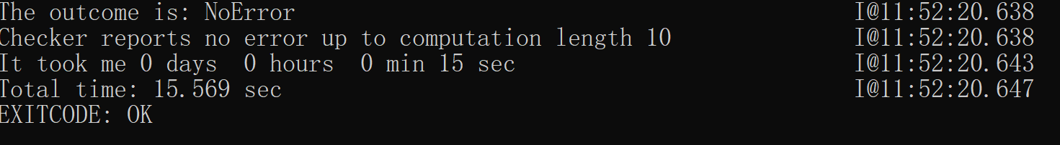
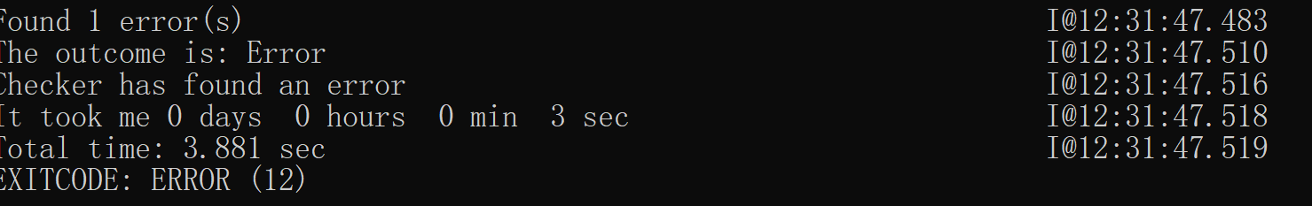
Checking Quicksort

Slide 21
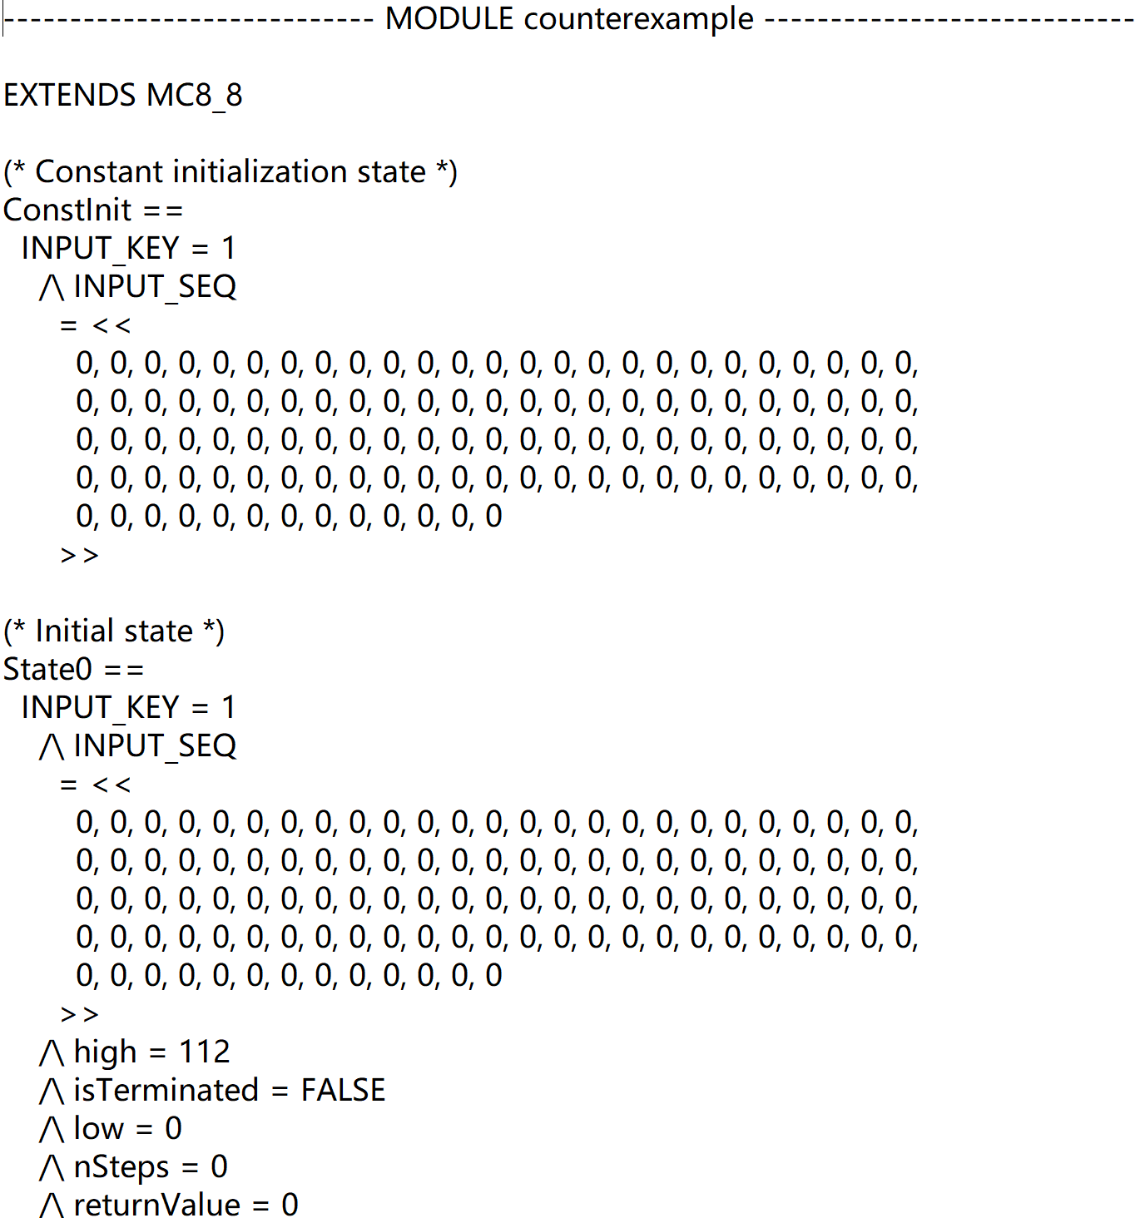
Checking Quicksort

Slide 22
Some Rules for Apalache Assignment

Slide 23
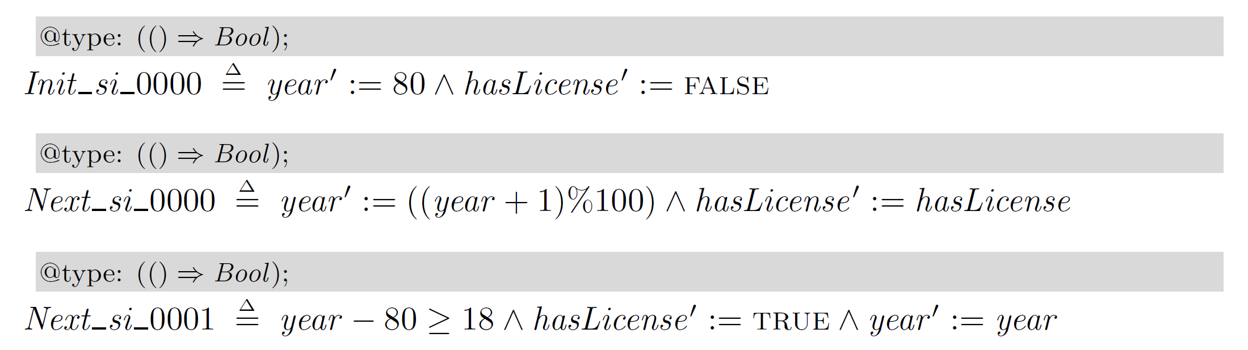
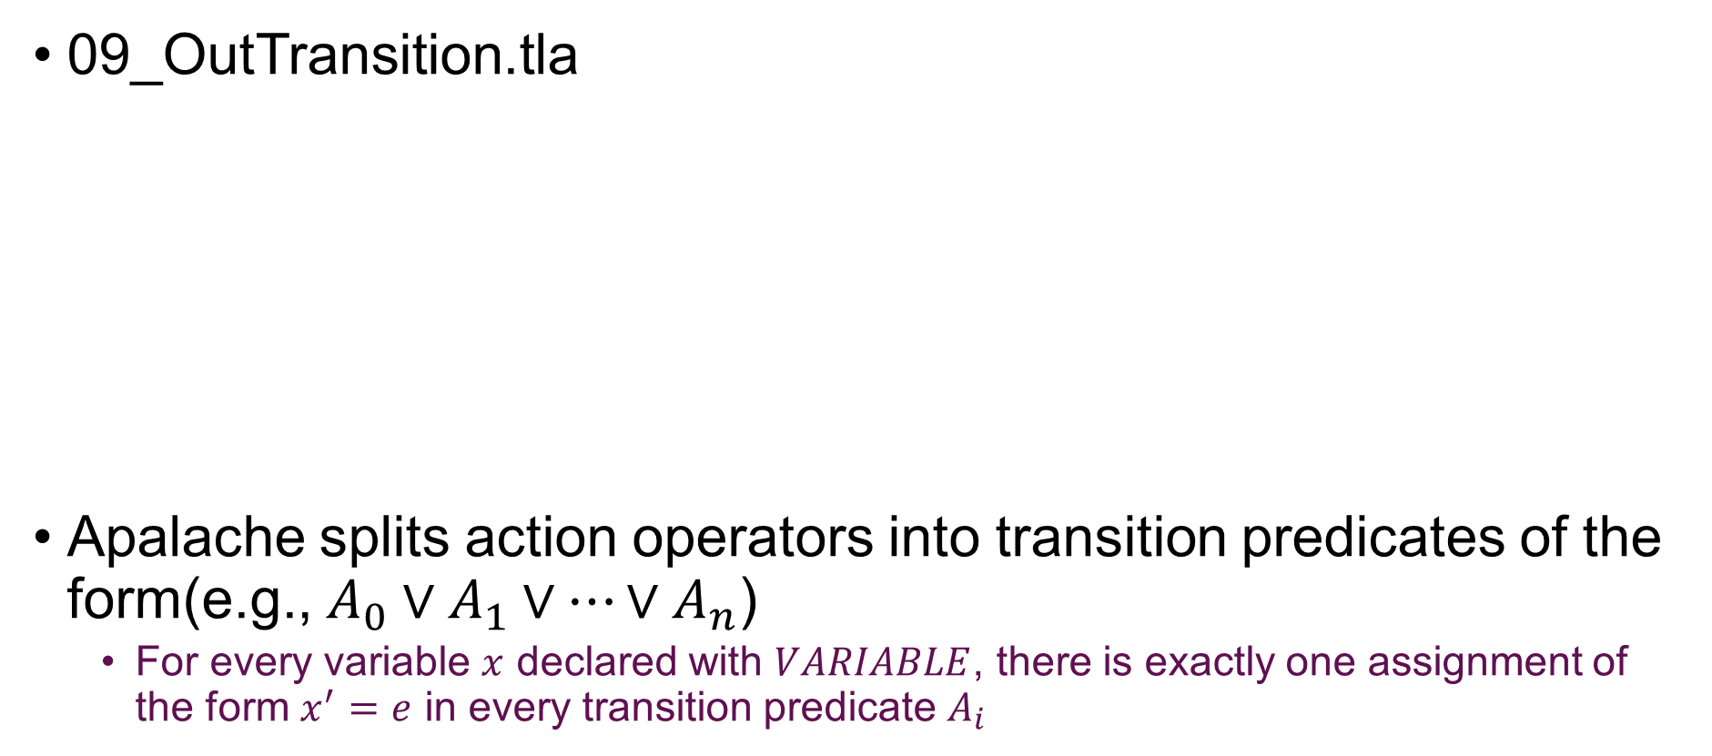
Assignments and Symbolic Transitions
09_OutTransition.tla
Apalache splits action operators into transition predicates of the form(e.g., $A_{0}∨A_{1}∨⋯{∨A}_{n}$)
For every variable $x$ declared with $VARIABLE$, there is exactly one assignment of the form $x^{′}=e$ in every transition predicate $A_{i}$
Notes:
使用-intermediate选项，可以得到中间结果
apalache生成这样的symbolic transition需要满足一定的条件，与TLC会有些不同

Slide 24
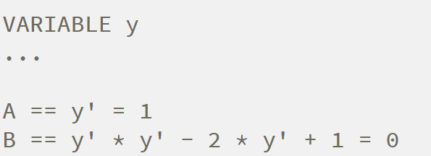
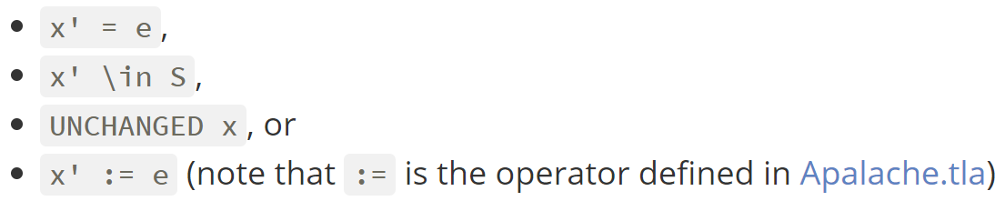
Explicit Enumeration

Slide 25
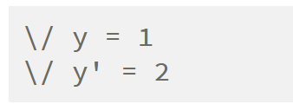
Balace
In or-operator, all assignments must have assignments for the same set of variables

Slide 26
More Topics
More rules for assignment
Module
Configuration files
Profiling
Known issues
File tuning
…
Refer to https://apalache.informal.systems/

Slide 27
Thank You

